Slide 1
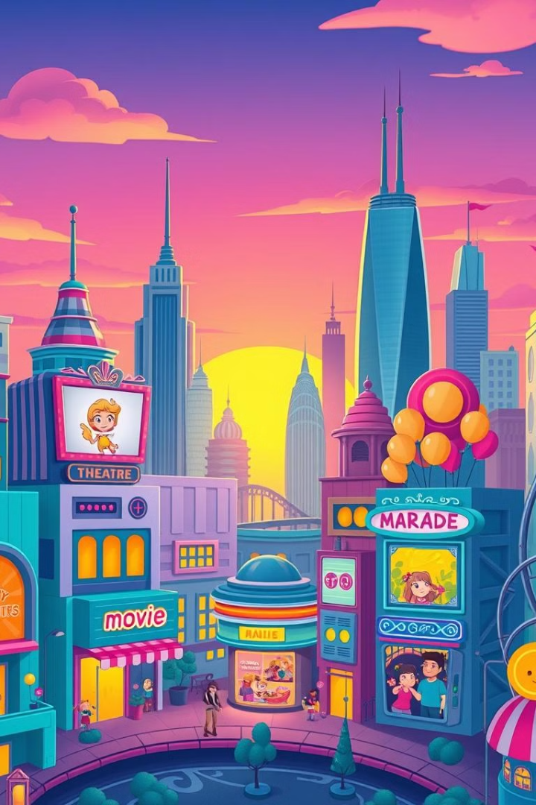

Netflix's Design Thinking Journey: A Case Study
This presentation explores how Netflix successfully used design thinking to navigate a rapidly changing industry, overcome key challenges, and maintain its position as a global entertainment leader.
Notes:
1

Slide 2
Intro to Design Thinking
Human-Centered Approach
Iterative Process
Focuses on understanding user needs and desires to create solutions that are both effective and desirable.
Involves testing and refining ideas through prototyping and user feedback, leading to continuous improvement.
Notes:
2

Slide 3

Netflix's Challenge: Adapting to a Changing Industry
1
1. Increasing Competition
2
2. Shifting Consumer Preferences
The emergence of new streaming services, such as Disney+, HBO Max, and Apple TV+, significantly intensified competition.
Consumers have become accustomed to more personalized content recommendations and on-demand viewing experiences.
Notes:
3

Slide 4

Understanding the User: Netflix's Customer Research
Surveys
Focus Groups
Gathering feedback on user preferences, viewing habits, and overall satisfaction with the platform.
Facilitating discussions to gain insights into user needs, pain points, and ideas for improvement.
A/B Testing
Experimenting with different features and designs to determine which ones resonate best with users.
Notes:
4

Slide 5
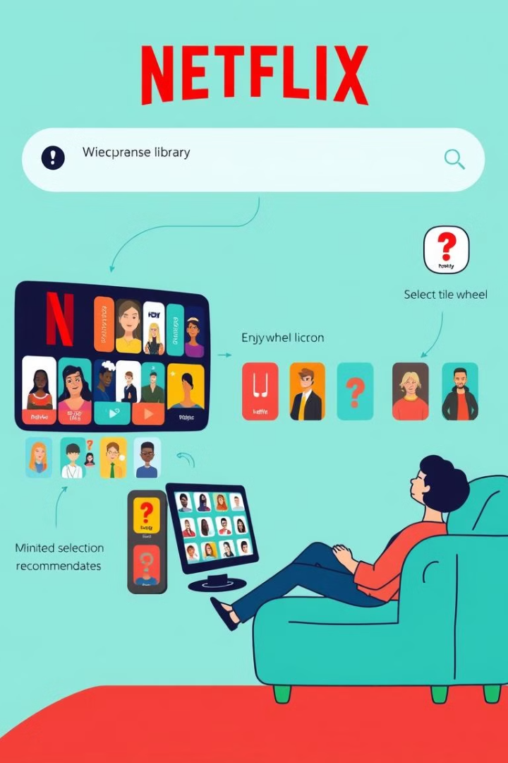


Defining the Problem: Identifying Key Pain Points
Limited Search Functionality
Poor Content Recommendations
Users struggled to find specific content they were interested in, leading to frustration and abandonment.
The recommendation algorithm didn't always provide relevant content, resulting in a lack of engagement and churn.
Notes:
5

Slide 6

Ideating Solutions: Netflix's Brainstorming Process
1
Idea Generation
Teams brainstormed a wide range of solutions to address the identified pain points, focusing on user needs and potential improvements.
2
Idea Evaluation
The team critically evaluated the feasibility and effectiveness of each solution, prioritizing those that had the highest impact.
Notes:
6

Slide 7
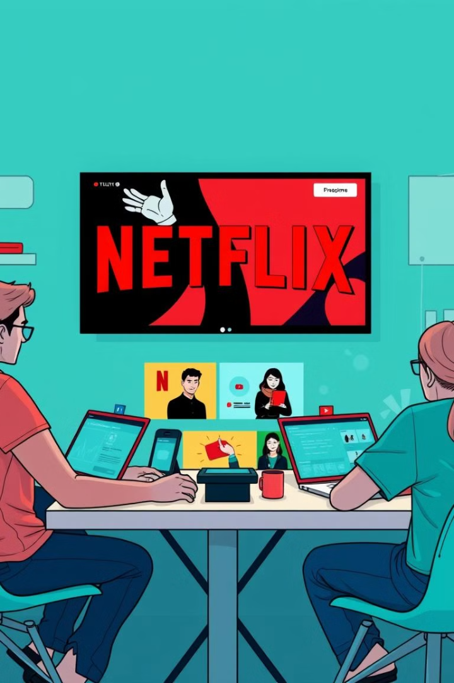


Prototyping and Testing: Iterating on Ideas
Rapid Prototyping
The team quickly created prototypes of their ideas, allowing for visual representation and user testing.
User Testing
They gathered feedback from real users to assess the usability, effectiveness, and overall satisfaction of the prototypes.
Notes:
7

Slide 8



Implementing the Solution: Netflix's Design Thinking Execution
Improved Search Filters
1
Expanding search filters to include more specific criteria, allowing users to easily find the content they're looking for.
Personalized Recommendations
2
Enhancing the recommendation algorithm to better understand user preferences and suggest more relevant content.
Enhanced Navigation
3
Streamlining the user interface, making it easier to navigate and find desired content.
Notes:
8

Slide 9
Overcoming Obstacles: How Netflix Solved Problems
Technical Challenges
1
The team overcame technical challenges by collaborating with engineers to ensure seamless integration and scalability.
User Adoption
2
Addressing user concerns through clear communication and ongoing iterations to ensure a positive user experience.
Notes:
9

Slide 10

Netflix's Success: A Data-Driven Transformation
These design thinking-driven solutions yielded positive results for Netflix.
The company experienced increased user satisfaction, engagement, and retention.
Notes:
10

Slide 11

Key Takeaways: Lessons from Netflix's Design Thinking Strategy
1
Empathy
Prioritizing user needs and understanding their challenges and preferences.
2
Iteration
Constantly testing and refining solutions based on user feedback and data analysis.
3
Collaboration
Fostering a culture of collaboration and open communication among teams.
Notes:
11

Slide 12


